Slide 1
Statistics for Managers
Using Microsoft® Excel
5th Edition
Chapter 16
Time-Series Forecasting and Index Numbers
Statistics for Managers Using Microsoft Excel, 5e © 2008 Prentice-Hall, Inc.
Chap 16-<number>

Slide 2
Learning Objectives
In this chapter, you learn:
About seven different time-series forecasting models: moving averages, exponential smoothing, the linear trend, the quadratic trend, the exponential trend, the autoregressive, and the least-squares models for seasonal data.
To choose the most appropriate time-series forecasting model
About price indexes and the difference between aggregated and simple indexes
Statistics for Managers Using Microsoft Excel, 5e © 2008 Prentice-Hall, Inc.
Chap 16-<number>

Slide 3
The Importance of Forecasting
Governments forecast unemployment, interest rates, and expected revenues from income taxes for policy purposes
Marketing executives forecast demand, sales, and consumer preferences for strategic planning
College administrators forecast enrollments to plan for facilities and for faculty recruitment
Retail stores forecast demand to control inventory levels, hire employees and provide training
Statistics for Managers Using Microsoft Excel, 5e © 2008 Prentice-Hall, Inc.
Chap 16-<number>

Slide 4
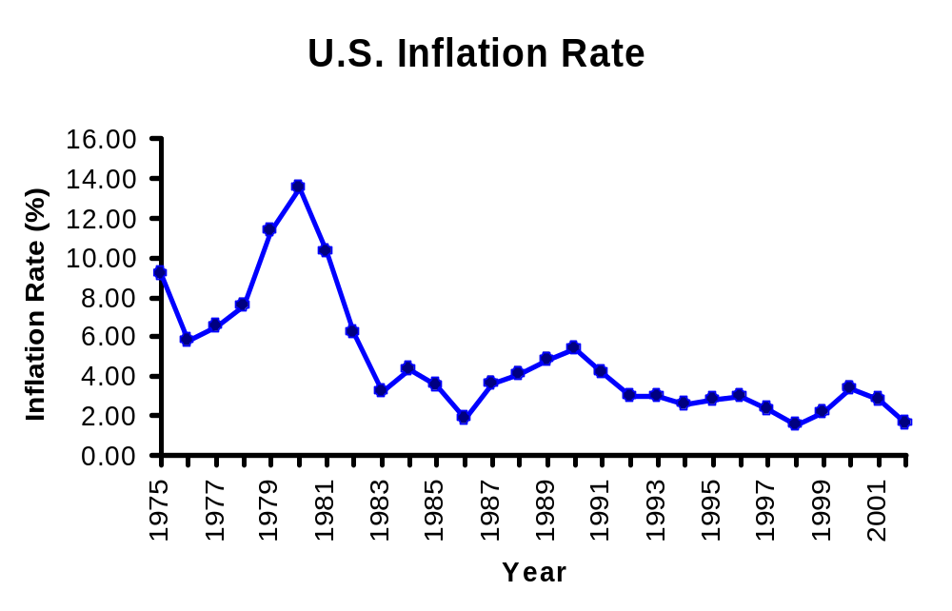
Time Series Plot
A time-series plot is a two-dimensional plot of time-series data
the vertical axis measures the variable of interest
the horizontal axis corresponds to the time periods
Statistics for Managers Using Microsoft Excel, 5e © 2008 Prentice-Hall, Inc.
Chap 16-<number>

Slide 5
Time-Series Components
Time Series
Trend Component
Seasonal Component
Cyclical Component
Irregular Component
Statistics for Managers Using Microsoft Excel, 5e © 2008 Prentice-Hall, Inc.
Chap 16-<number>

Slide 6
Trend Component
Long-run increase or decrease over time (overall upward or downward movement)
Data taken over a long period of time
Sales
Upward trend
Time
Statistics for Managers Using Microsoft Excel, 5e © 2008 Prentice-Hall, Inc.
Chap 16-<number>

Slide 7
Trend Component
Trend can be upward or downward
Trend can be linear or non-linear
Sales
Sales
Time
Time
Downward linear trend
Upward nonlinear trend
Statistics for Managers Using Microsoft Excel, 5e © 2008 Prentice-Hall, Inc.
Chap 16-<number>

Slide 8
Seasonal Component
Short-term regular wave-like patterns
Observed within 1 year
Often monthly or quarterly
Sales
Summer
Winter
Summer
Winter
Spring
Fall
Spring
Fall
Time (Quarterly)
Statistics for Managers Using Microsoft Excel, 5e © 2008 Prentice-Hall, Inc.
Chap 16-<number>

Slide 9
Cyclical Component
Long-term wave-like patterns
Regularly occur but may vary in length
Often measured peak to peak or trough to trough
1 Cycle
Sales
Year
Statistics for Managers Using Microsoft Excel, 5e © 2008 Prentice-Hall, Inc.
Chap 16-<number>

Slide 10
Irregular Component
Unpredictable, random, “residual” fluctuations
Due to random variations of
  Nature
  Accidents or unusual events
“Noise” in the time series
Statistics for Managers Using Microsoft Excel, 5e © 2008 Prentice-Hall, Inc.
Chap 16-<number>

Slide 11
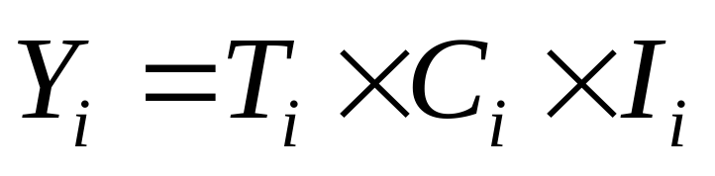
Multiplicative Time-Series Model for Annual Data
Used primarily for forecasting
Observed value in time series is the product of components
where T_{i} = Trend value at year i
C_{i} = Cyclical value at year i
I_{i} = Irregular (random) value at year i
Statistics for Managers Using Microsoft Excel, 5e © 2008 Prentice-Hall, Inc.
Chap 16-<number>

Slide 12

Multiplicative Time-Series Model with a Seasonal Component
Used primarily for forecasting
Allows consideration of seasonal variation
where T_{i} = Trend value at time i
S_{i} = Seasonal value at time i
C_{i} = Cyclical value at time i
I_{i} = Irregular (random) value at time i
Statistics for Managers Using Microsoft Excel, 5e © 2008 Prentice-Hall, Inc.
Chap 16-<number>

Slide 13
Smoothing the
Annual Time Series
Calculate moving averages to get an overall impression of the pattern of movement over time
Moving Average: averages of consecutive time series values for a chosen period of length L
Statistics for Managers Using Microsoft Excel, 5e © 2008 Prentice-Hall, Inc.
Chap 16-<number>

Slide 14
Moving Averages
Used for smoothing
A series of arithmetic means over time
Result dependent upon choice of L (length of period for computing means)
Examples:
  For a 5 year moving average, L = 5
  For a 7 year moving average, L = 7
Statistics for Managers Using Microsoft Excel, 5e © 2008 Prentice-Hall, Inc.
Chap 16-<number>

Slide 15
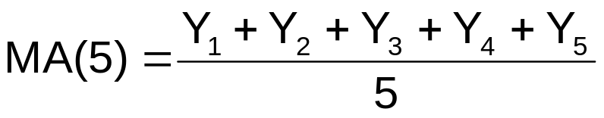
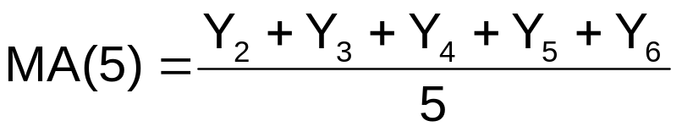
Moving Averages
Example: Five-year moving average
  First average:
  Second average:
Statistics for Managers Using Microsoft Excel, 5e © 2008 Prentice-Hall, Inc.
Chap 16-<number>

Slide 16
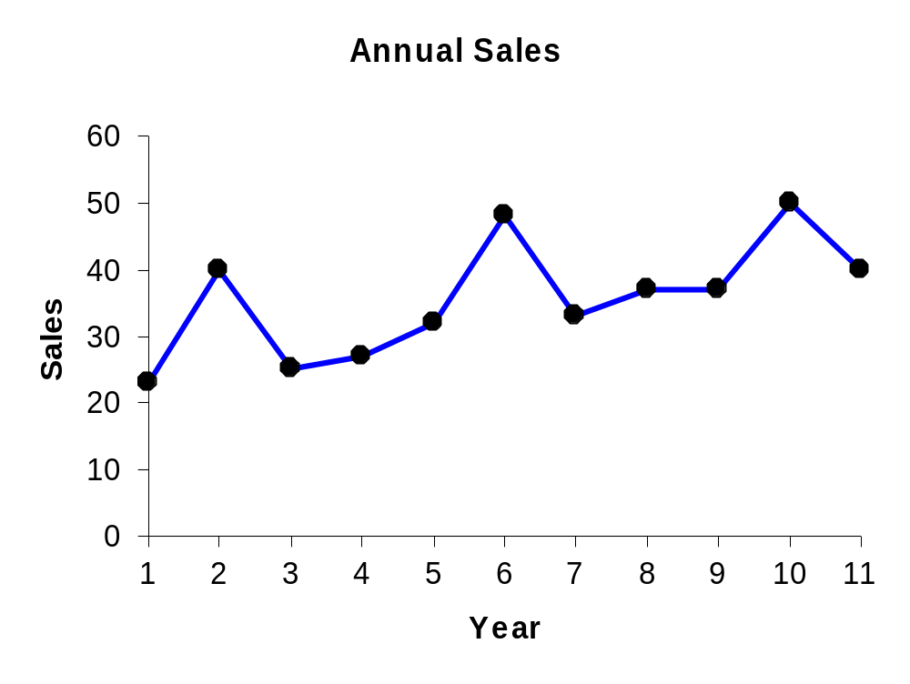
Example: Annual Data
Year | Sales
1 2 3 4 5 6 7 8 9 10 11 etc… | 23 40 25 27 32 48 33 37 37 50 40 etc…
Statistics for Managers Using Microsoft Excel, 5e © 2008 Prentice-Hall, Inc.
Chap 16-<number>

Slide 17
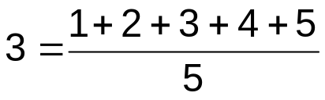
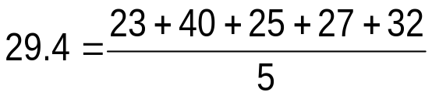
Example: Annual Data
Average Year | 5-Year Moving Average
3 | 29.4
4 | 34.4
5 | 33.0
6 | 35.4
7 | 37.4
8 | 41.0
9 | 39.4
… | …
Year | Sales
1 | 23
2 | 40
3 | 25
4 | 27
5 | 32
6 | 48
7 | 33
8 | 37
9 | 37
10 | 50
11 | 40
etc…
Each moving average is for a consecutive block of 5 years
Statistics for Managers Using Microsoft Excel, 5e © 2008 Prentice-Hall, Inc.
Chap 16-<number>

Slide 18
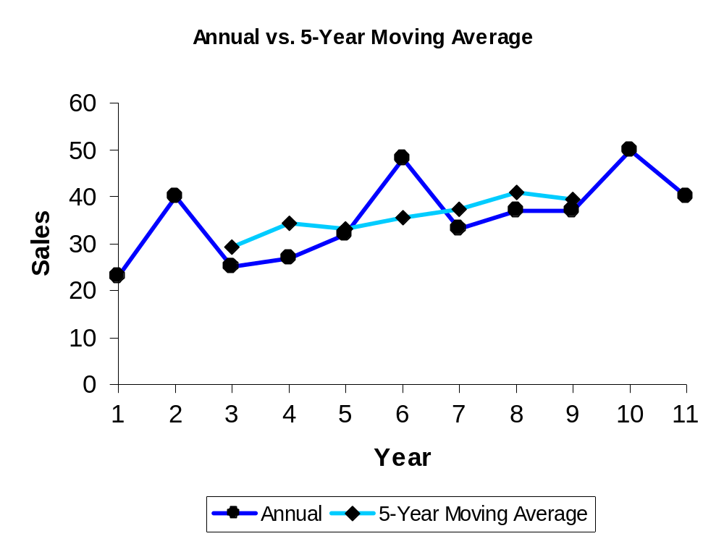
Annual vs. Moving Average
The 5-year moving average smoothes the data and shows the underlying trend
Statistics for Managers Using Microsoft Excel, 5e © 2008 Prentice-Hall, Inc.
Chap 16-<number>

Slide 19
Exponential Smoothing
Used for smoothing and short term forecasting (often one period into the future)
A weighted moving average
  Weights decline exponentially
  Most recent observation weighted most
Statistics for Managers Using Microsoft Excel, 5e © 2008 Prentice-Hall, Inc.
Chap 16-<number>

Slide 20
Exponential Smoothing
The weight (smoothing coefficient) is W
  Subjectively chosen
  Range from 0 to 1
  Smaller W gives more smoothing, larger W gives less smoothing
The weight is:
  Close to 0 for smoothing out unwanted cyclical and irregular components
  Close to 1 for forecasting
Statistics for Managers Using Microsoft Excel, 5e © 2008 Prentice-Hall, Inc.
Chap 16-<number>

Slide 21
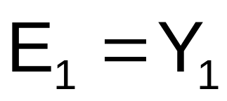
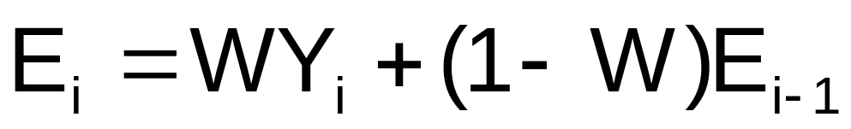
Exponential Smoothing Model
Exponential smoothing model
For i = 2, 3, 4, …
where:
E_{i} = exponentially smoothed value for period i
E_{i-1} = exponentially smoothed value already
computed for period i - 1
Y_{i} = observed value in period i
W = weight (smoothing coefficient), 0 < W < 1
Statistics for Managers Using Microsoft Excel, 5e © 2008 Prentice-Hall, Inc.
Chap 16-<number>

Slide 22
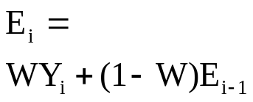
Exponential Smoothing Example
Suppose we use weight W = .2
Time Period (i) | Sales (Y_{i}) | Forecast from prior period (E_{i-1}) | Exponentially Smoothed Value for this period (E_{i})
1 2 3 4 5 6 7 8 9 10 | 23 40 25 27 32 48 33 37 37 50 | -- 23 26.4 26.12 26.296 27.437 31.549 31.840 32.872 33.697 | 23 (.2)(40)+(.8)(23)=26.4 (.2)(25)+(.8)(26.4)=26.12 (.2)(27)+(.8)(26.12)=26.296 (.2)(32)+(.8)(26.296)=27.437 (.2)(48)+(.8)(27.437)=31.549 (.2)(48)+(.8)(31.549)=31.840 (.2)(33)+(.8)(31.840)=32.872 (.2)(37)+(.8)(32.872)=33.697 (.2)(50)+(.8)(33.697)=36.958
E₁ = Y₁ since no prior information exists
Statistics for Managers Using Microsoft Excel, 5e © 2008 Prentice-Hall, Inc.
Chap 16-<number>

Slide 23
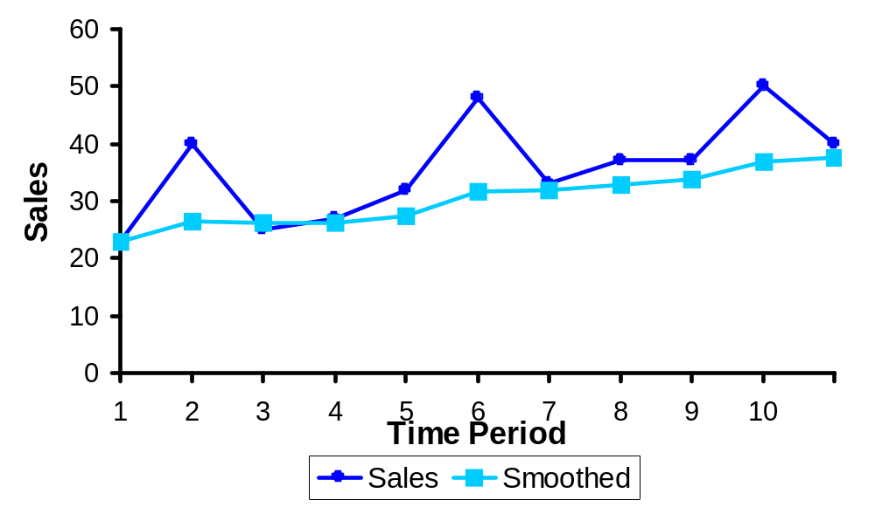
Exponential Smoothing Example
Fluctuations have been smoothed
NOTE: the smoothed value in this case is generally a little low, since the trend is upward sloping and the weighting factor is only .2
Statistics for Managers Using Microsoft Excel, 5e © 2008 Prentice-Hall, Inc.
Chap 16-<number>

Slide 24
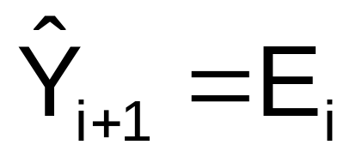
Forecasting Time Period i + 1
The smoothed value in the current period (i) is used as the forecast value for next period (i + 1) :
Statistics for Managers Using Microsoft Excel, 5e © 2008 Prentice-Hall, Inc.
Chap 16-<number>

Slide 25
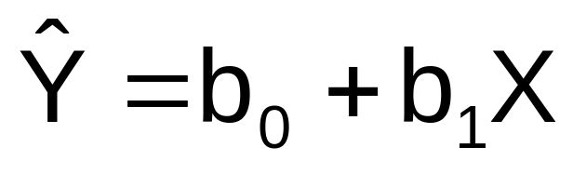
Least Squares Linear Trend-Based Forecasting
Estimate a trend line using regression analysis
Use time (X) as the independent variable:
Year | Time Period (X) | Sales (Y)
1999 2000 2001 2002 2003 2004 | 0 1 2 3 4 5 | 20 40 30 50 70 65
Statistics for Managers Using Microsoft Excel, 5e © 2008 Prentice-Hall, Inc.
Chap 16-<number>

Slide 26
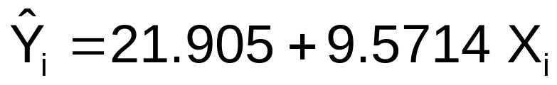
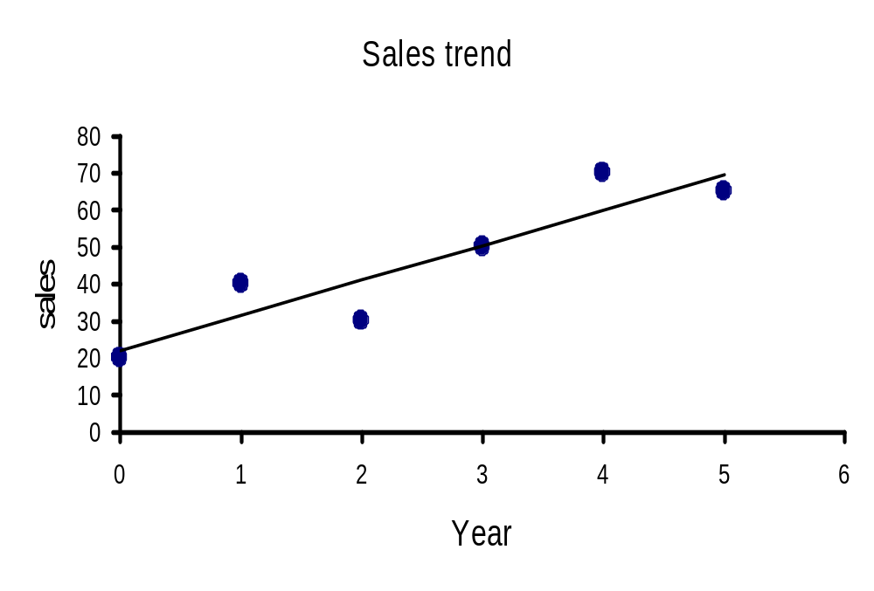
Least Squares Linear Trend-Based Forecasting
The linear trend forecasting equation is:
Year | Time Period (X) | Sales (Y)
1999 2000 2001 2002 2003 2004 | 0 1 2 3 4 5 | 20 40 30 50 70 65
Statistics for Managers Using Microsoft Excel, 5e © 2008 Prentice-Hall, Inc.
Chap 16-<number>

Slide 27
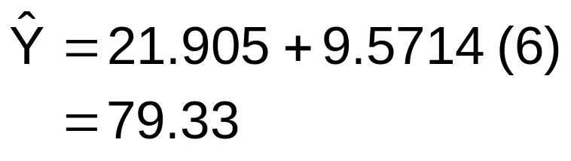
Least Squares Linear Trend-Based Forecasting
Forecast for time period 6
Year | Time Period (X) | Sales (y)
1999 2000 2001 2002 2003 2004 2005 | 0 1 2 3 4 5 6 | 20 40 30 50 70 65 ??
Statistics for Managers Using Microsoft Excel, 5e © 2008 Prentice-Hall, Inc.
Chap 16-<number>

Slide 28
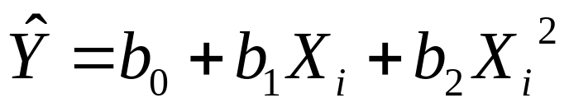
Least Squares Quadratic Trend-Based Forecasting
A nonlinear regression model can be used when the time series exhibits a nonlinear trend
Quadratic Trend Forecasting Equation:
Test quadratic term for significance
Can try other functional forms to get best fit
Statistics for Managers Using Microsoft Excel, 5e © 2008 Prentice-Hall, Inc.
Chap 16-<number>

Slide 29
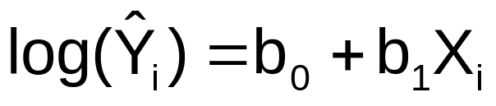

Least Squares Exponential Trend-Based Forecasting
Exponential trend forecasting equation:
where b₀ = estimate of log(β₀)
b₁ = estimate of log(β₁)
Interpretation:
is the estimated annual compound
growth rate (in %)
Statistics for Managers Using Microsoft Excel, 5e © 2008 Prentice-Hall, Inc.
Chap 16-<number>

Slide 30
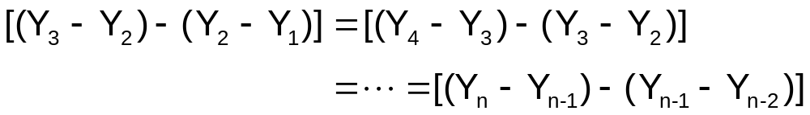
Model Selection Using Differences
Use a linear trend model if the first differences are approximately constant
Use a quadratic trend model if the second differences are approximately constant
Statistics for Managers Using Microsoft Excel, 5e © 2008 Prentice-Hall, Inc.
Chap 16-<number>

Slide 31
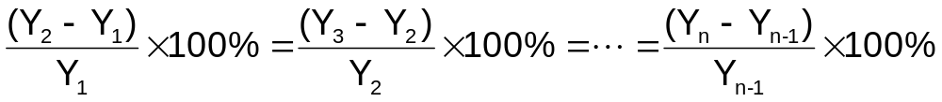
Model Selection Using Differences
Use an exponential trend model if the percentage differences are approximately constant
Statistics for Managers Using Microsoft Excel, 5e © 2008 Prentice-Hall, Inc.
Chap 16-<number>

Slide 32
Autoregressive Modeling
Used for forecasting
Takes advantage of autocorrelation
  1st order - correlation between consecutive values
  2nd order - correlation between values 2 periods apart
p^{th} order Autoregressive models:
Random Error
Statistics for Managers Using Microsoft Excel, 5e © 2008 Prentice-Hall, Inc.
Chap 16-<number>

Slide 33
Autoregressive Modeling
Example
The Office Concept Corp. has acquired a number of office units (in thousands of square feet) over the last eight years. Develop the second order Autoregressive model.
Year Units
97 4
98 3
99 2
00 3
01 2
02 2
03 4
04 6
Statistics for Managers Using Microsoft Excel, 5e © 2008 Prentice-Hall, Inc.
Chap 16-<number>

Slide 34
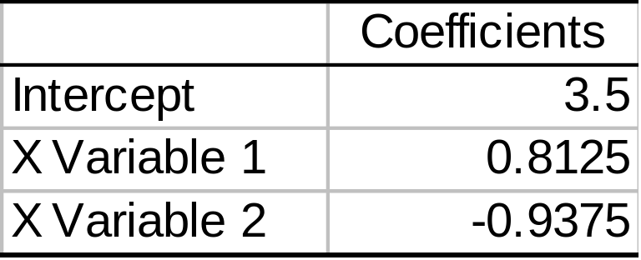
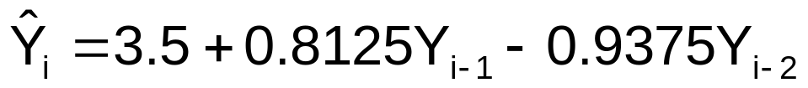
Autoregressive Modeling
Example
Year Y_{i} Y_{i-1} Y_{i-2}
97 4 -- --
98 3 4 --
99 2 3 4
00 3 2 3
01 2 3 2
02 2 2 3
03 4 2 2
04 6 4 2
Develop the 2nd order table
Use Excel to estimate a regression model
Excel Output
Statistics for Managers Using Microsoft Excel, 5e © 2008 Prentice-Hall, Inc.
Chap 16-<number>

Slide 35
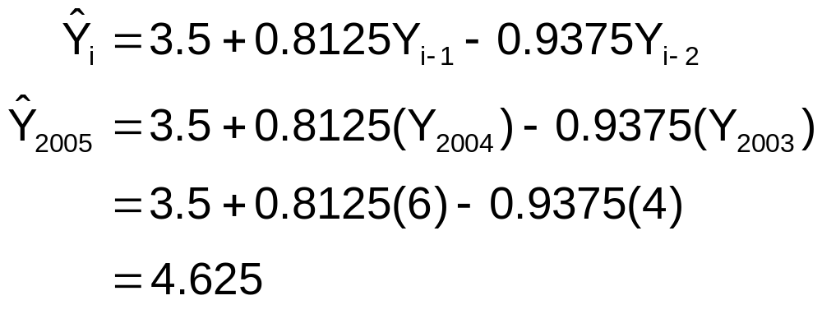
Autoregressive Modeling
Example
Use the second-order equation to forecast number of units for 2005:
Statistics for Managers Using Microsoft Excel, 5e © 2008 Prentice-Hall, Inc.
Chap 16-<number>

Slide 36
Autoregressive Modeling Steps
1. Choose p (note that df = n – 2p – 1)
2. Form a series of “lagged predictor” variables
Y_{i-1} , Y_{i-2} , … ,Y_{i-p}
3. Use Excel to run regression model using all p variables
4. Test significance of A_{p}
  If null hypothesis rejected, this model is selected
  If null hypothesis not rejected, decrease p by 1 and repeat
Statistics for Managers Using Microsoft Excel, 5e © 2008 Prentice-Hall, Inc.
Chap 16-<number>

Slide 37
Selecting A Forecasting Model
Perform a residual analysis
  Look for pattern or direction
Measure magnitude of residual error using squared differences
Measure residual error using MAD
Use simplest model
  Principle of parsimony
Statistics for Managers Using Microsoft Excel, 5e © 2008 Prentice-Hall, Inc.
Chap 16-<number>

Slide 38
Residual Analysis
e
e
0
0
T
T
Random errors
Cyclical effects not accounted for
e
e
0
0
T
T
Trend not accounted for
Seasonal effects not accounted for
Statistics for Managers Using Microsoft Excel, 5e © 2008 Prentice-Hall, Inc.
Chap 16-<number>

Slide 39
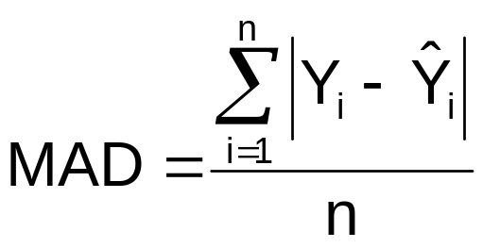
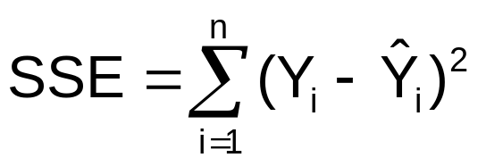
Measuring Errors
Choose the model that gives the smallest SSE and/or MAD
Sum of squared errors (SSE)
  Sensitive to outliers
Mean Absolute Deviation (MAD)
  Not sensitive to outliers
Statistics for Managers Using Microsoft Excel, 5e © 2008 Prentice-Hall, Inc.
Chap 16-<number>

Slide 40
Principal of Parsimony
Suppose two or more models provide a good fit for the data
Select the simplest model
  Simplest model types:
    Least-squares linear
    Least-squares quadratic
    1st order autoregressive
  More complex types:
    2nd and 3rd order autoregressive
    Least-squares exponential
Statistics for Managers Using Microsoft Excel, 5e © 2008 Prentice-Hall, Inc.
Chap 16-<number>

Slide 41
Forecasting With Seasonal Data
Recall the classical time series model with seasonal variation:
Suppose the seasonality is quarterly
  Define three new dummy variables for quarters:
  Q₁ = 1 if first quarter, 0 otherwise
  Q₂ = 1 if second quarter, 0 otherwise
  Q₃ = 1 if third quarter, 0 otherwise
  (Quarter 4 is the default if Q₁ = Q₂ = Q₃ = 0)
Statistics for Managers Using Microsoft Excel, 5e © 2008 Prentice-Hall, Inc.
Chap 16-<number>

Slide 42
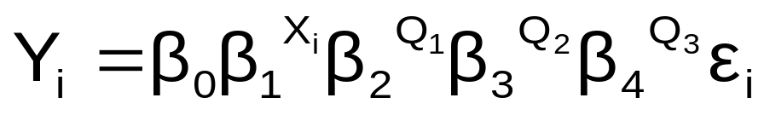
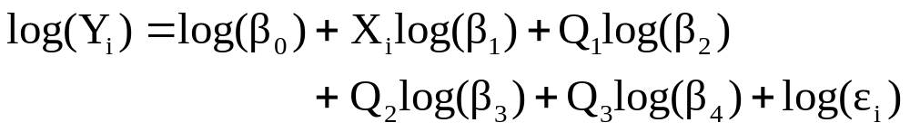
Exponential Model with Quarterly Data
(β₁-1)*100% = estimated quarterly compound growth rate (in %)
β₂ = estimated multiplier for first quarter relative to fourth quarter
β₃= estimated multiplier for second quarter relative to fourth quarter
β₄= estimated multiplier for third quarter relative to fourth quarter
Transform to linear form:
Statistics for Managers Using Microsoft Excel, 5e © 2008 Prentice-Hall, Inc.
Chap 16-<number>

Slide 43
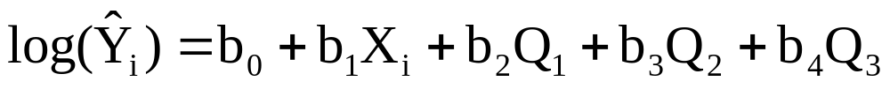



Estimating the Quarterly Model
Exponential forecasting equation:
where b₀ = estimate of log(β₀)
b₁ = estimate of log(β₁)
etc…
Interpretation:
= estimated quarterly compound growth rate (in %)
= estimated multiplier for first quarter relative to fourth quarter
= estimated multiplier for second quarter relative to fourth quarter
= estimated multiplier for third quarter relative to fourth quarter
Statistics for Managers Using Microsoft Excel, 5e © 2008 Prentice-Hall, Inc.
Chap 16-<number>

Slide 44





Quarterly Model Example
Suppose the forecasting equation is:
b₀ = 3.43, so
b₁ = .017, so
b₂ = -.082, so
b₃ = -.073, so
b₄ = .022, so
Statistics for Managers Using Microsoft Excel, 5e © 2008 Prentice-Hall, Inc.
Chap 16-<number>

Slide 45





Quarterly Model Example
Value:
Interpretation:
Unadjusted trend value for first quarter of first year
4.0% = estimated quarterly compound growth rate
Ave. sales in Q₂ are 82.7% of average 4th quarter sales, after adjusting for the 4% quarterly growth rate
Ave. sales in Q₃ are 84.5% of average 4th quarter sales, after adjusting for the 4% quarterly growth rate
Ave. sales in Q₄ are 105.2% of average 4th quarter sales, after adjusting for the 4% quarterly growth rate
Statistics for Managers Using Microsoft Excel, 5e © 2008 Prentice-Hall, Inc.
Chap 16-<number>

Slide 46
Index Numbers
Index numbers allow relative comparisons over time
Index numbers are reported relative to a base period index
Base period index = 100 by definition
Statistics for Managers Using Microsoft Excel, 5e © 2008 Prentice-Hall, Inc.
Chap 16-<number>

Slide 47
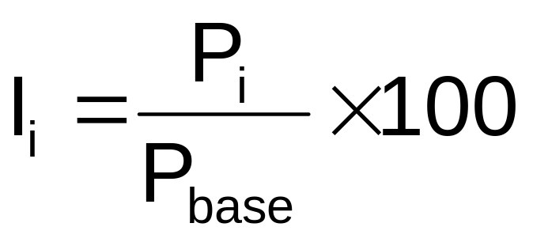
Simple Price Index
Simple Price Index:
where
I_{i} = index number for year i
P_{i} = price for year i
P_{base} = price for the base year
Statistics for Managers Using Microsoft Excel, 5e © 2008 Prentice-Hall, Inc.
Chap 16-<number>

Slide 48
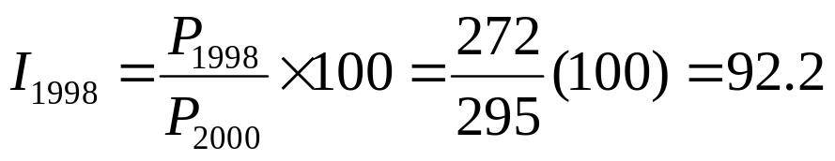
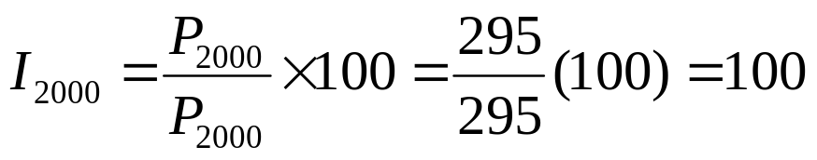
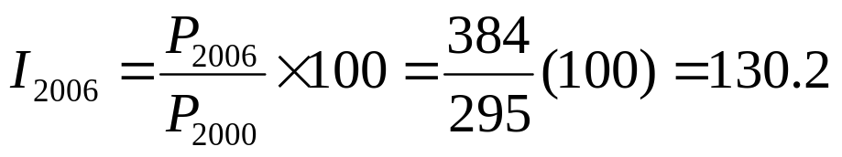
Index Numbers: Example
Airplane ticket prices from 1998 to 2006:
Year | Price | Index (base year = 2000)
1998 | 272 | 92.2
1999 | 288 | 97.6
2000 | 295 | 100
2001 | 311 | 105.4
2002 | 322 | 109.2
2003 | 320 | 108.5
2004 | 348 | 118.0
2005 | 366 | 124.1
2006 | 384 | 130.2
Statistics for Managers Using Microsoft Excel, 5e © 2008 Prentice-Hall, Inc.
Chap 16-<number>

Slide 49

Index Numbers: Interpretation
Prices in 1998 were 92.2% of base year prices
Prices in 2000 were 100% of base year prices (by definition, since 2000 is the base year)
Prices in 2006 were 130.2% of base year prices
Statistics for Managers Using Microsoft Excel, 5e © 2008 Prentice-Hall, Inc.
Chap 16-<number>

Slide 50
Aggregate Price Indexes
An aggregate index is used to measure the rate of change from a base period for a group of items
Aggregate Price Indexes
Unweighted aggregate price index
Weighted aggregate price indexes
Paasche Index
Laspeyres Index
Statistics for Managers Using Microsoft Excel, 5e © 2008 Prentice-Hall, Inc.
Chap 16-<number>

Slide 51
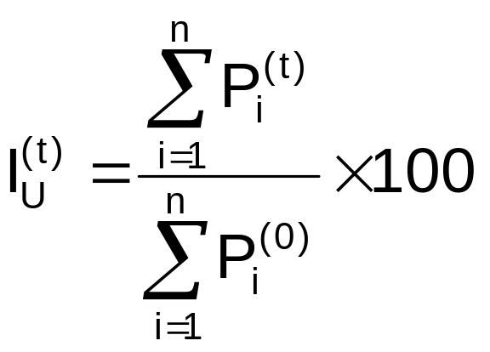
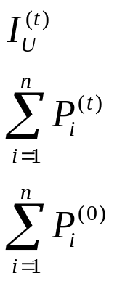
Unweighted
Aggregate Price Index
Unweighted aggregate price index formula:
i = item
t = time period
n = total number of items
= unweighted price index at time t
= sum of the prices for the group of items at time t
= sum of the prices for the group of items in time period 0
Statistics for Managers Using Microsoft Excel, 5e © 2008 Prentice-Hall, Inc.
Chap 16-<number>

Slide 52
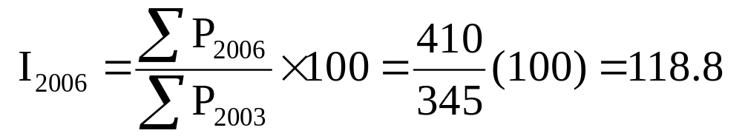
Unweighted Aggregate Price Index: Example
 | Automobile Expenses: Monthly Amounts ($):
Year | Lease payment | Fuel | Repair | Total | Index (2003=100)
2003 | 260 | 45 | 40 | 345 | 100.0
2004 | 280 | 60 | 40 | 380 | 110.1
2005 | 305 | 55 | 45 | 405 | 117.4
2006 | 310 | 50 | 50 | 410 | 118.8
Unweighted total expenses were 18.8% higher in 2006 than in 2003
Statistics for Managers Using Microsoft Excel, 5e © 2008 Prentice-Hall, Inc.
Chap 16-<number>

Slide 53
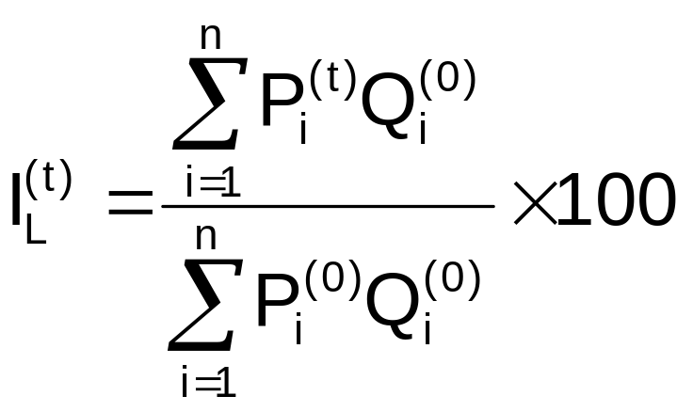
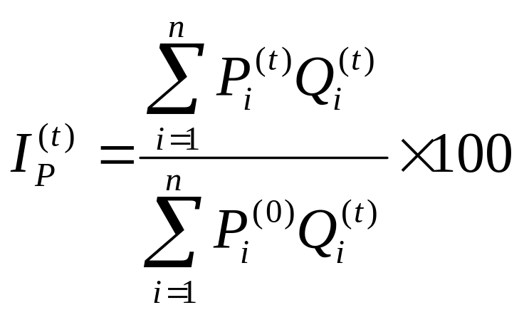




Weighted
Aggregate Price Indexes
Laspeyres index
Paasche index
= weights based on = weights based on current
period 0 quantities period quantities
= price in time period t
= price in period 0
Statistics for Managers Using Microsoft Excel, 5e © 2008 Prentice-Hall, Inc.
Chap 16-<number>

Slide 54
Common Price Indexes
Consumer Price Index (CPI)
Producer Price Index (PPI)
Stock Market Indexes
  Dow Jones Industrial Average
  S&P 500 Index
  NASDAQ Index
Statistics for Managers Using Microsoft Excel, 5e © 2008 Prentice-Hall, Inc.
Chap 16-<number>

Slide 55
Pitfalls in
Time-Series Analysis
Assuming the mechanism that governs the time series behavior in the past will still hold in the future
Using mechanical extrapolation of the trend to forecast the future without considering personal judgments, business experiences, changing technologies, and habits, etc.
Statistics for Managers Using Microsoft Excel, 5e © 2008 Prentice-Hall, Inc.
Chap 16-<number>

Slide 56
Chapter Summary
In this chapter, we have
Discussed the importance of forecasting
Addressed component factors of the time-series model
Performed smoothing of data series
  Moving averages
  Exponential smoothing
Described least squares trend fitting and forecasting
  Linear, quadratic and exponential models
Statistics for Managers Using Microsoft Excel, 5e © 2008 Prentice-Hall, Inc.
Chap 16-<number>

Slide 57
Chapter Summary
In this chapter, we have
Addressed autoregressive models
Described procedure for choosing appropriate models
Addressed time series forecasting of monthly or quarterly data (use of dummy variables)
Discussed pitfalls concerning time-series analysis
Discussed index numbers
Statistics for Managers Using Microsoft Excel, 5e © 2008 Prentice-Hall, Inc.
Chap 16-<number>

